Slide 1
Introduction to Cloud Computing

Slide 2
Cloud Computing in the News
Tom Vanderbilt, Data Center Overload, NY Times, June 14, 2009
“And so when you think about Hotmail supporting 375 million users, or search supporting three billion queries a month, or Messenger supporting hundreds of millions of users, you can easily assume that those properties are very large properties for our company.”
In his book “The Big Switch,” Nicholas Carr draws an analogy between the rise of mega-data centers and the Industrial Revolution. Just as nascent industries, once powered by water wheels, were by the 20th century able to “run their machines with electric current generated in distant power plants,” advances in technology and transmission speeds are permitting computing to function like a utility, a distant but ever-accessible cloud of services.
Instead of buying software and hiring I.T. employees, companies can outsource things like customer relationship management, or C.R.M., the database software that companies use to track client interactions, to an Internet company like salesforce.com, which sells subscriptions, or seats, to its services. “Customers who have two seats on salesforce.com, like a mom-and-pop flower shop, have access to the same application as a customer that has 65,000 seats …

Slide 3
Cloud Computing in the News
Kelly Fiveash, Microsoft calls in the builders for Dublin data centre, The Register, 7th November 2007
Microsoft is shelling out $500m on a new European data centre in Ireland to support its growing online business.
There will be tens of thousands of servers pumping out web-based apps to internet fanciers all over the world, the company says.
But it only needs to hire between 15 and 20 staff to run the behemoth's first Windows Live data centre not on US soil, because much of the system will be automated.
Microsoft, which already has some 1,200 staff at a separate office in Ireland, said work would begin later this month and it expects the centre to open for business by 2009.
Crain's Chicago Business reports that construction on a new $500m site large enough to hold eight [American] football fields was already underway

Slide 4

Cloud Computing in the News
Wired, Cloud Computing Available at Amazon.com Today, 4/12/2008
Click on "Amazon Web Services." Key in your Amazon ID and password and behold: a data center's worth of computing power carved into megabyte-sized chunks and wired straight to your desktop. Clones of that HP tower cost 10 cents per hour — 10 cents! — and they're set to start spitting out widgets as soon as you upload the code. Virtual quad cores are a princely 80 cents an hour. Need storage? All you can eat for 15 cents per gigabyte per month. And there's even a tool for monitoring your virtual stack with an iPhone. No precious cash tied up in soon-to-be-obsolete silicon, no 3 am runs to the colo cage. Outsource your infrastructure to Amazon!

Slide 5
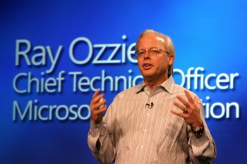
Cloud Computing in the News
Steven Levy, Ray Ozzie Wants to Push Microsoft Back Into Startup Mode, Wired, 11/24/2008
According to Microsoft, one example of a successful service is Windows Update, which automatically installs patches and bug fixes on users' operating systems. Hotmail, like all Web‐based mail applications, is also a service. Virtual Earth? A service. Software, but not from a box. Still, Ozzie draws the line at the idea that you can do anything and everything in the cloud, that every application can become Web based, that the desktop is dead. Some things, he says, still require local computation, offline persistence, and the control that only one's own desktop processor offers.
Ray's Plan: 4 Ways to Win
Not long after Ray Ozzie arrived at Microsoft in 2005, he wrote a memo declaring that the company's survival hinged on a shift to cloud computing. Three years later, Ozzie and Microsoft are finally announcing (though for the most part not yet releasing) key products designed to fulfill that promise.

Slide 6
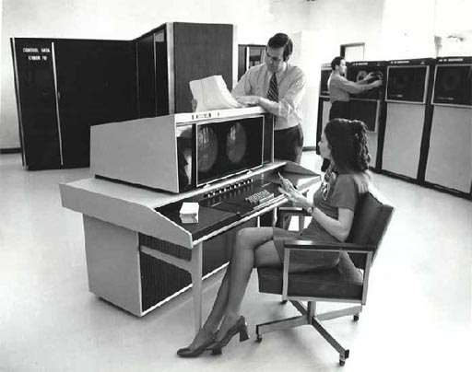
In the Beginning was the Mainframe and Terminals
Users did individual work by connecting to central computer
Notes:
Found this diagram on the web, can’t remember where. Need something similar to it, or to Heinzelreiter & Kurschl, slide 21

Slide 7
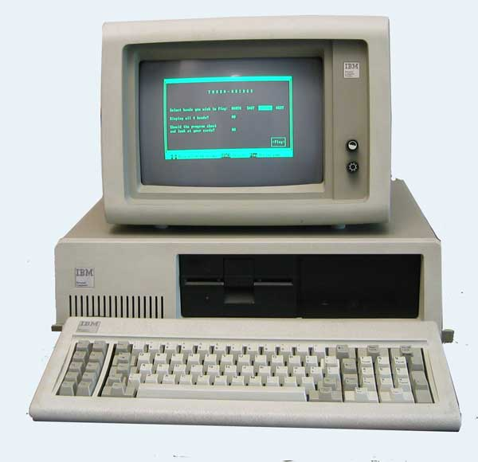
Next came PCs
Users did individual work
on their own desktops
Notes:
Same diagram, replace dumb terminals with PCs, remove server. Don’t link the PCs, they’re standalone

Slide 8
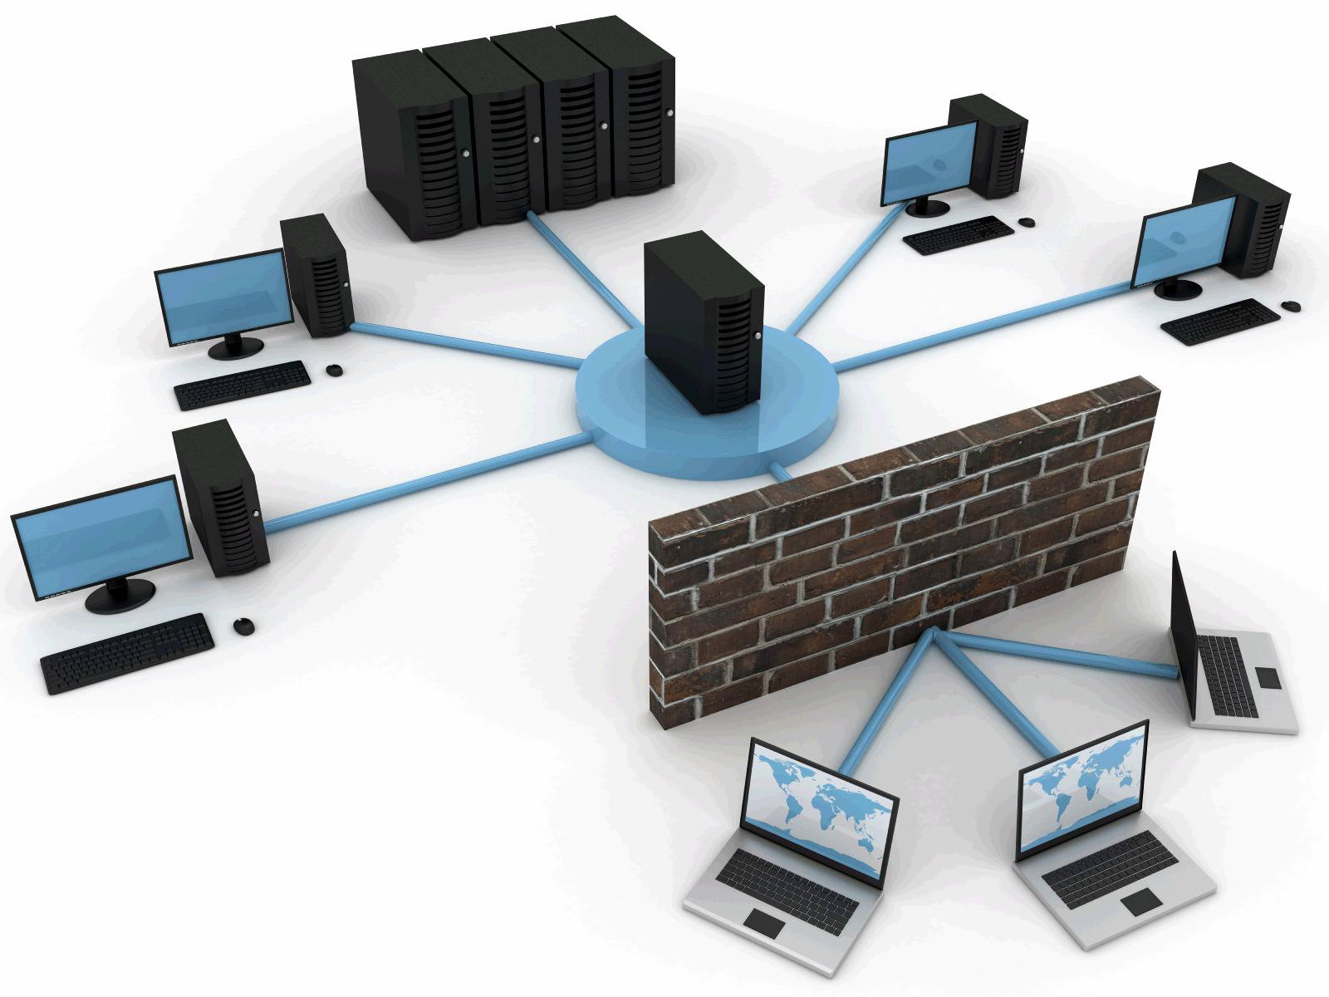
Then the PCs Got Tied Together
Users could talk to each other’s PCs
Notes:
Same as previous slide, but now link PCs together with cables peer-to-peer

Slide 9

Then came the Web
Users did individual work by connecting to web servers
Notes:
Same as previous slide, but connect PCs to a small central server. Similar to H&K slide 22

Slide 10
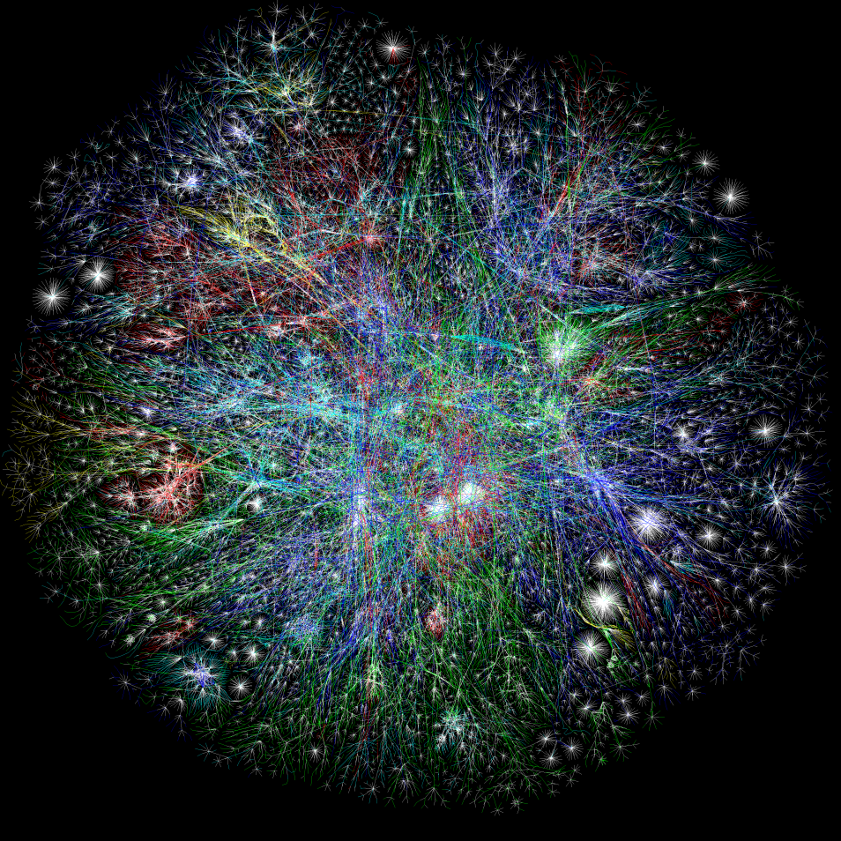
Then the Web got big
Server had to become
cluster of PCs
Notes:
Similar to H&K slide 23, but don’t bother with the data tier, just PC clients going to a rack of PC server. Same as previous slide, but now with bigger server, a rack of PCs.

Slide 11
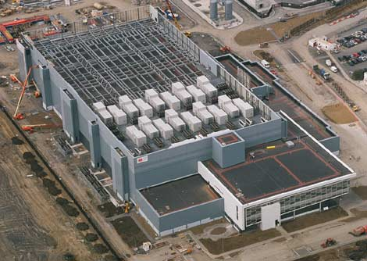
Then the Web got REALLY big, and really important
Server PCs had to live in
expensive data center
Microsoft Data Center in Dublin, 27,000 m², 22 MW, US$ 500 M
Notes:
This is a MS picture, so I think we’re OK on rights

Slide 12
Data Centers
Need lots of electric power (e.g. 1.5% of all US electricity, EPA 2007)
Long lead time to build
Inflexible investment of capital
Need specialized skills (security, failover, load balancing, etc.)
Takes time away from core competencies
Hard for all but largest companies to own/run

Slide 13
Solution: Outsource Data Center
Can reap economies of scale
Because of scale, can afford specialized skills
Web developers can concentrate on their core competencies that give them market advantage
Shorter lead times
Lower capital requirements
Computing power becomes a commodity, as did electric power in early 20th century

Slide 14
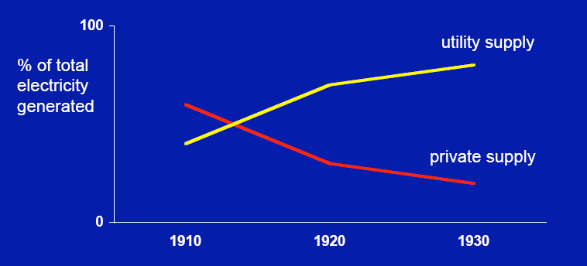
Similar to Electrification in Early 20th Century
See The Big Switch: Rewiring the World, from Edison to Google , by Nicholas Carr, Norton, 2008, from which this chart is taken
Notes:
This diagram is slide 15 at http://www.nicholasgcarr.com/download/carrOSBC.pdf . Please obtain permission

Slide 15
Types of Clouds
Private
(On-Premise)
Infrastructure
(as a Service)
Platform
(as a Service)
Software
(as a Service)
You manage
Applications
Applications
Applications
Applications
You manage
Runtimes
Runtimes
Runtimes
Runtimes
Security & Integration
Security & Integration
Security & Integration
Security & Integration
Managed by vendor
Managed by vendor
Databases
Databases
Databases
Databases
You manage
Servers
Servers
Managed by vendor
Servers
Servers
Virtualization
Virtualization
Virtualization
Virtualization
Server HW
Server HW
Server HW
Server HW
Storage
Storage
Storage
Storage
Networking
Networking
Networking
Networking

Slide 16
Current Cloud Platforms

Slide 17
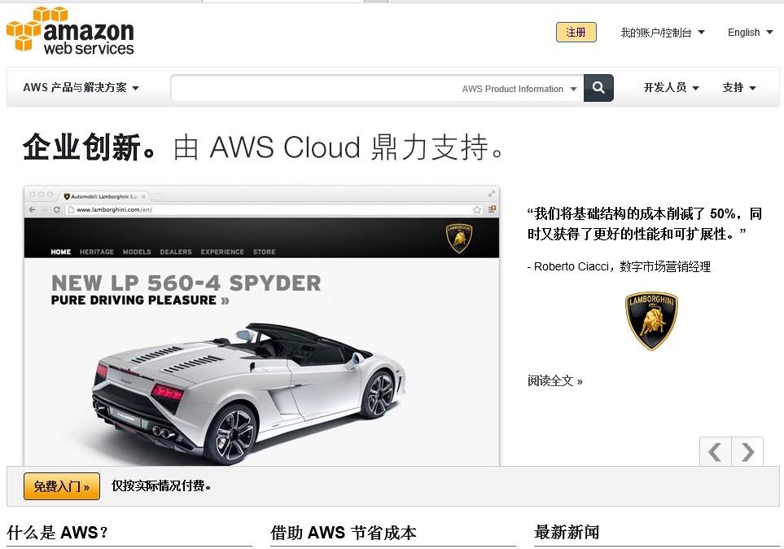
Amazon Web Services

Slide 18
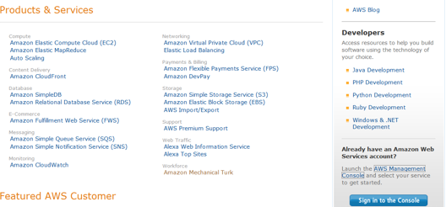
Amazon Web Services

Slide 19
Amazon Web Services
Launched in 2002
Run by Amazon.com
Programmed in many languages, including Java, Python, Ruby, and .NET
Evolved from basic computing to add commerce-based services, such as payment and fulfillment

Slide 20
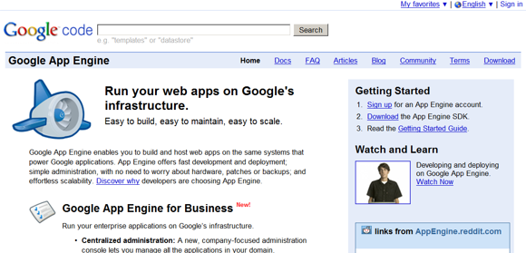
Google App Engine

Slide 21
Google App Engine
Released in 2008
Primary languages are Python and Java
Currently provides basic computing and storage; a few more simple things. Can’t imagine that won’t increase and evolve.

Slide 22
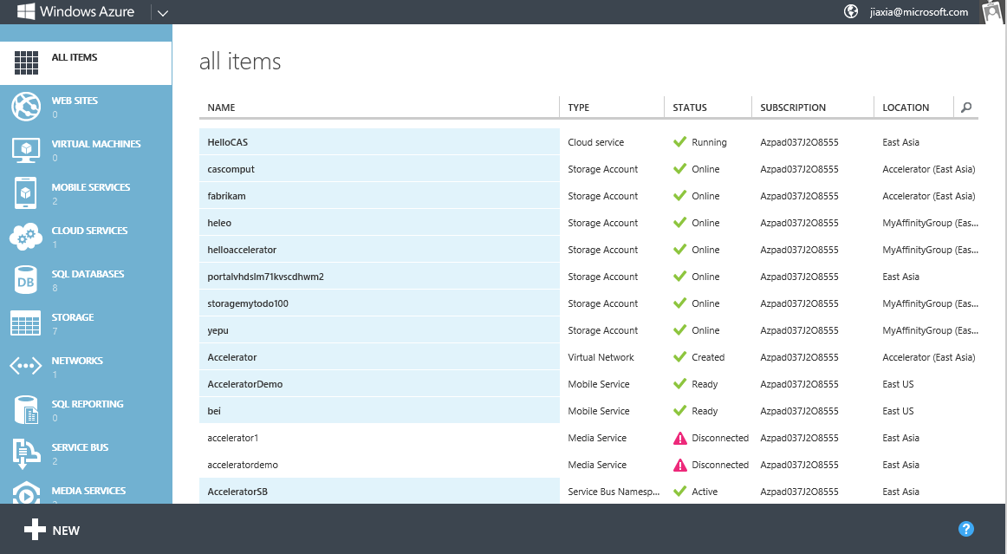
Microsoft Azure

Slide 23
Microsoft Azure
Launched in 2009
Program in .NET
Provides computation and storage services
Allows access to underlying cloud system for sophisticated tweaking
I expect to see additional business services as well, perhaps provided by third parties

Slide 24
Workload Patterns Optimal For Cloud

Slide 25
On and Off
Inactivity
Period
On &off workloads (e.g. batch job)
Example: scientists running modeling software for new drug
Installed capacity is wasted when not being used, but:
Users twiddle thumbs expensively while waiting for jobs to finish

Slide 26
Growing Fast
Successful services need to grow and scale
Example: new Internet game that catches on
Deployment and scaling lags can stunt growth at key critical
moment. See “Pogue effect” on Line2 iPhone app
Need capital for software development or marketing instead of
building data center

Slide 27
Predictable Bursting
Many services have seasonality trends, either macro (FTD Florists
and Valentine’s Day) or micro (Domino’s Pizza on Super Bowl
Sunday), or any restaurant at peak meal hours.
Installed capacity is wasted when not being used, but lack of
sufficient capacity at key moment could kill business

Slide 28
Unpredictable Bursting
Unexpected/unplanned peak in demand
Extreme example: CNN.com on 9/11/01
Less extreme example: Weather.com as a big storm moves in
Can’t afford to provision for extreme case, but failure
to handle it well can kill a brand
Take care: if you depend on handling bursts for your company’s
life, be very careful about service level agreement

Slide 29
What If Cloud Dies ?
The cloud probably has better availability than you could do on your own. However:
Consider retaining as much in-house capacity as you need to stay alive and muddle through
Example: hospital or police department, which get electricity from grid for normal operations but keep backup generator for vital functions in case of outage.

Slide 30
Ultra-Sensitive Data
Some core, vital data you just can’t trust to anyone else. Example: Fidelity account contents, US Department of Defense submarine locations. Can’t use external cloud, but might consider internal cloud appliances, with safeguards.
These companies often have much larger stores of data with lower security requirements for which cloud could be highly appropriate. Example: Fidelity fund prospecti and reports, US DoD purchases of coffee and underwear.

Slide 31
Legal
Sometimes law requires that certain data be stored in specific countries or locations .
Sometimes you want data stored in specific locations to avoid any possible uncertainties in jurisdiction (MS HealthVault in Canada).
Technology changing faster than law can keep up. More than a little bit tricky. Cloud could hurt (hosting not available in required jurisdiction) or help (quick switch of hosting into newly required jurisdiction).

Slide 32
Availability of Cloud Resources
How sure are you that your cloud provider will have enough cloud resources available when you want to scale up, particularly in burst situations?
How badly would it hurt your business if you wanted to scale up but couldn’t?
What remedies are available from cloud provider if you cannot scale at the time you want, to the degree that you want? (See service level agreement with provider.)

Slide 33
Demo Hello, Cloud Application
Notes:
Azure.com

Slide 34
Thanks!

Slide 35
Appendix

Slide 36

How does Cloud Computing differ from:
Cluster Computing
Grid Computing
Utility Computing
Autonomic Computing
Parallel Computing

Slide 37
Cluster Computing
Cluster computing refers to the use of tightly coupled set of computer machines to achieve a single purpose.
It is a form of distributed computing in limited fashion.
The challenges it faces is much limited.
It does not consider the interactive end user
Thus, it is not cloud computing, per se.
However, cloud computing may contains elements of it.

Slide 38
Grid Computing
Pooling compute resources
For scientific computing and simulation
from multiple administrative domains
Virtual Supercomputer, Virtual Organizations
SPMD - Same Program Multiple Data
coarse grained parallel applications
Examples
SETI@HOME, Globus toolkit (GTK)
Berkeley Open Infrastructure for Network Computing

Slide 39
Grid vs. Cloud
Grid never considered the interactive end user
jobs are being submitted through portals
results are being retrieved hours later
in form of log files and collected program output
Grid did not integrate administrative domains
install certificates, enable ssh login, and
setting up mutual trust relationships across all partners
Creating a huge, distributed virtual supercomputer
which is managed in a batch-job-processing scheme.

Slide 40
Utility Computing
Packaging of IT resources into a metered service
CPU, memory, network bandwidth, storage
similar to traditional utilities (such as the telephone network).
Low initial costs
pay-per-use billing model
quick reaction to changes in demand of IT services
Not a new concept
long history in world of ultra-reliable but expensive mainframe
a model for capacity-based charging

Slide 41
Autonomic Computing
Operator does not control the system directly
policies and rules serve as input for self-management
coined by IBM
Self-* functional areas:
Self-Configuration: Automatic configuration of components;
Self-Healing: Automatic discovery, and correction of faults;
Self-Optimization: Automatic monitoring/control of resources
Self-Protection: Protection from arbitrary attacks
Cloud computing infrastructures (often called "the fabric") have to follow autonomic computing principles

Slide 42
Parallel Computing
Parallel computing is concurrent computing
meaning multiple tasks are executed simultaneously.
Cloud computing may or may not necessitate parallel computing
Thus, Map/Reduce, OpenCL, etc. are not cloud computing, per se.
However, cloud computing often contains elements of parallelism.

Slide 43
Confusion about “Cloud Computing”
Very different meaning to different people
Some believe that hosting software on a remote server is CC
Some believe that coordination between SW and HW is CC
Some believe that Map/Reduce is CC
Some believe that data center computing is CC
Some believe that CC is Internet computing
Some believe that CC is distributed computing
Some believe that CC is network computing
Many more don’t have a clue as to what CC is

Slide 44
Confusion about “Cloud Computing”
App delivery as an on-demand service, is no longer novel
The benefits of scalability, reliability, security, ease of deployment, and ease of management for customers, traded off against
worries of trust, privacy, availability, performance, ownership, and supplier persistence, still stand.
The dream of platform independence
Platforms such as Google App Engine promise application deployment on large, robust servers for instant scalability, security, performance, but that’s only an ideal for now.

Slide 45
Confusion about “Cloud Computing”
Big words
According to The Economist, “Let it Rise,” October 2008
The rise of the cloud is more than just another platform shift that gets geeks excited. It will undoubtedly transform the information technology (IT) industry, but it will also profoundly change the way people work and companies operate. It will allow digital technology to penetrate every nook and cranny of the economy and of society, creating some tricky political problems along the way.
Substitute “cloud” with “Internet” and it will look familiar
How will cloud computing affect software development?

Slide 46
Confusion about “Cloud Computing”
Opportunities for developers
Cloud computing opens up exciting new possibilities based on a mix of old and new technologies for the next generation of software developers
Let smaller players tap into a larger user base that prefers the comfort of operating under the wings of a major player with lots of resources

Slide 47
Benefits of Cloud Computing
Agility
Cost
Device & Location Independence
Multi-Tenancy
Reliability
Scalability
Security
Sustainability

Slide 48
Example Applications
ExchangeOnline: E-mail, shared calendar, shared tasks, contacts
SharepointOnline: Portal, collaboration, content management, site search, and forms capabilities; Blog site templates that support article posting, reader comments, RSS feed generation
Office Live Meeting:
Interactive application/desktop sharing and whiteboard tools
Rich media presentations, native video conferencing, high-fidelity recording, and Web cam capabilities
Office 365

Slide 49
Example Applications
CRM from Salesforce.com
Google Maps
Dropbox
…

Slide 50
Challenges to Cloud Computing
Has to abstract underlying hardware
Be elastic in scaling to demand
Build on a pay per use basis
Who solves these questions best will dominiate the market

